Slide 1
Cookbook for Practice 5.3
实践5.3攻略
Cong Li 李聪

Slide 2
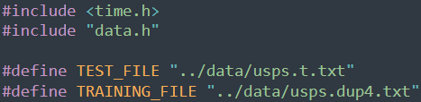
Basic Settings 基本设置
Create a new file ‘tile.cpp’
创建一个新文件’tile.cpp’
Similar to earlier work, include the header files & define the training & test data files
和以前的做法类似，应用头文件并定义训练和测试数据文件
Note that we use a larger training file this time
注意我们这里用了一个更大的训练文件

Slide 3
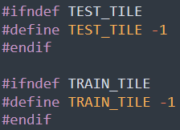
Tile Size Definition
分块大小定义
Allow configurable tile size definition in compilation
允许在编译时定义可变的分块大小
‘-1’ here stands for all the training/test data as the only tile
这里的’-1’表示所有的训练/测试数据作为唯一的块

Slide 4
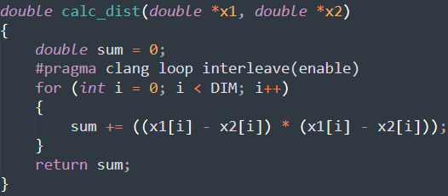
Distance Calculation 距离计算
Use the same function for Euclidean distance calculation
使用同样的计算欧氏距离的函数

Slide 5

Start of Main Program
主程序的开始 (1)
Start the ‘main’ function w/ reading the data
以读取数据作为’main’函数的开始
Set the right tile size for the ‘-1’ exception
处理’-1’的例外以配置分块大小

Slide 6
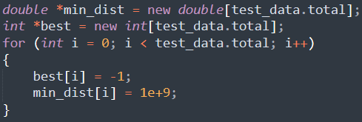
Start of Main Program
主程序的开始 (2)
Initialize 2 arrays to track the minimum distance & nearest neighbor observed so far for each sample
初始化两个数组，分别用来记录针对每一条测试数据到目前为止观察到的最近距离和对应的邻居

Slide 7


Flushing Cache 清空缓存
Take a look at ‘data.h’ for 2 functions for cache flushing
看一眼’data.h’里用来清空缓存的两个函数
Now back to ‘main’ function in ‘tile.cpp’, flush out the ‘hot’ data
回到’tile.cpp’里的’main’函数，把“热”数据冲刷掉
This prepares a ‘clean’ environment for the run
这为后续的运行准备了一个“干净”的环境

Slide 8
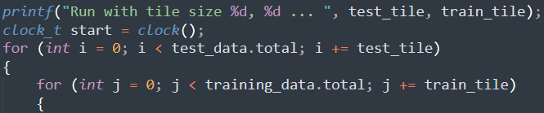
Tiled Processing 分块处理 (1)
Start timing, then a doubled loop over the
combination of the test tile & the training tile
开始计时，然后是双重循，遍历测试数据分块和训练数据分块的组合

Slide 9
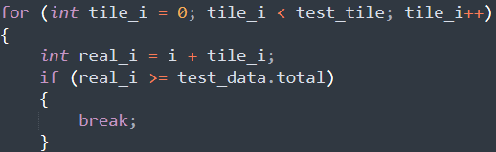
Tiled Processing 分块处理 (2)
Then the 3rd nested loop for samples in the test tile
然后是第三重内嵌循环，遍历测试数据分块中的所有数据
The ‘if’ branch to avoid walking across the end of the test data
这个’if’分支是防止越过测试数据的结束边界

Slide 10
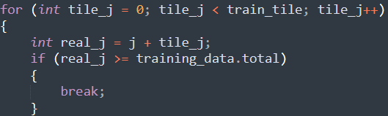
Tiled Processing 分块处理 (3)
Now the 4th nested loop for samples in the training tile
然后是第四重内嵌循环，遍历训练数据分块中的所有数据
Again, the ‘if’ branch to avoid walking across the end
这个’if’分支依然是防止越过结束边界

Slide 11
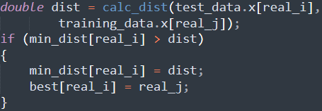
Tiled Processing 分块处理 (4)
Calculate the distance & update the corresponding
trackers if a nearer neighbor is found
计算距离，当找到一个更近的邻居时更新对应的记录

Slide 12
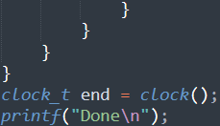
Tiled Processing 分块处理 (5)
Close the 4 loops & stop timing
结束四重循环，并停止计时

Slide 13
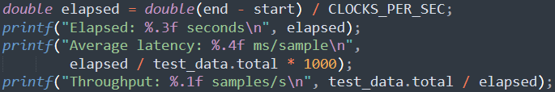
Result Output 结果输出 (1)
Print out the time spent, the average latency, & the throughput
打印总耗时、平均时延和吞吐量

Slide 14
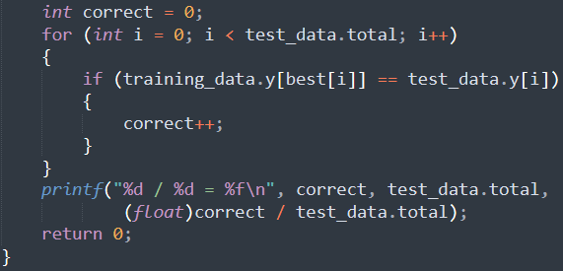
Result Output 结果输出 (2)
Calculate & print the classification accuracy
计算并输出分类准确率

Slide 15
Compile & Run It 编译并运行之
Compile & run the default run
编译并运行缺省配置
mingw32-make SRC=tile.cpp -B
run-tile.exe
Calculate the training & test tile size based on the CPU L1 cache & L2 cache size, then compile & run w/ the tiling setting.
根据CPU的L1、L2的缓存大小计算训练和
测试数据的分块大小，以该配置编译并运行
mingw32-make SRC=tile.cpp EXTRA_CXXFLAGS="-DTEST_TILE=500 -DTRAIN_TILE=20" -B
run-tile.exe

Slide 16
The End

